Slide 1

Research Progress Record
Enmao Diao
Nov 24, 2020

Slide 2
Overview
Multimodal Controller for Generative Models
Heterogenous Federated Learning
Smart Turbulence
Assisted Learning
Finite Neural Networks
Others
Preliminary Exam
Dissertation

Slide 3
Multimodal Controller for Generative Models
Paper submitted to ICASSP
We add experiments of COIL100 dataset since submitted to NeurIPS
We focus more one subnetworks and talk less about data creation
The latest version is mostly finalized

Slide 4
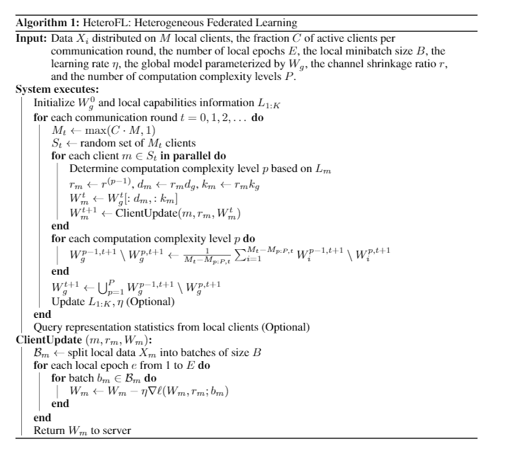
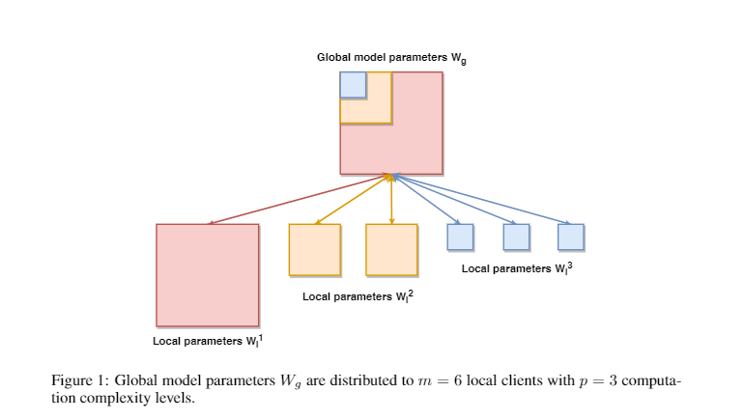
Heterogeneous Federated Learning
Submitted to ICLR (for now the score indicates a pass)
Enable training local models of different model complexity and produce a single global inference model

Slide 5
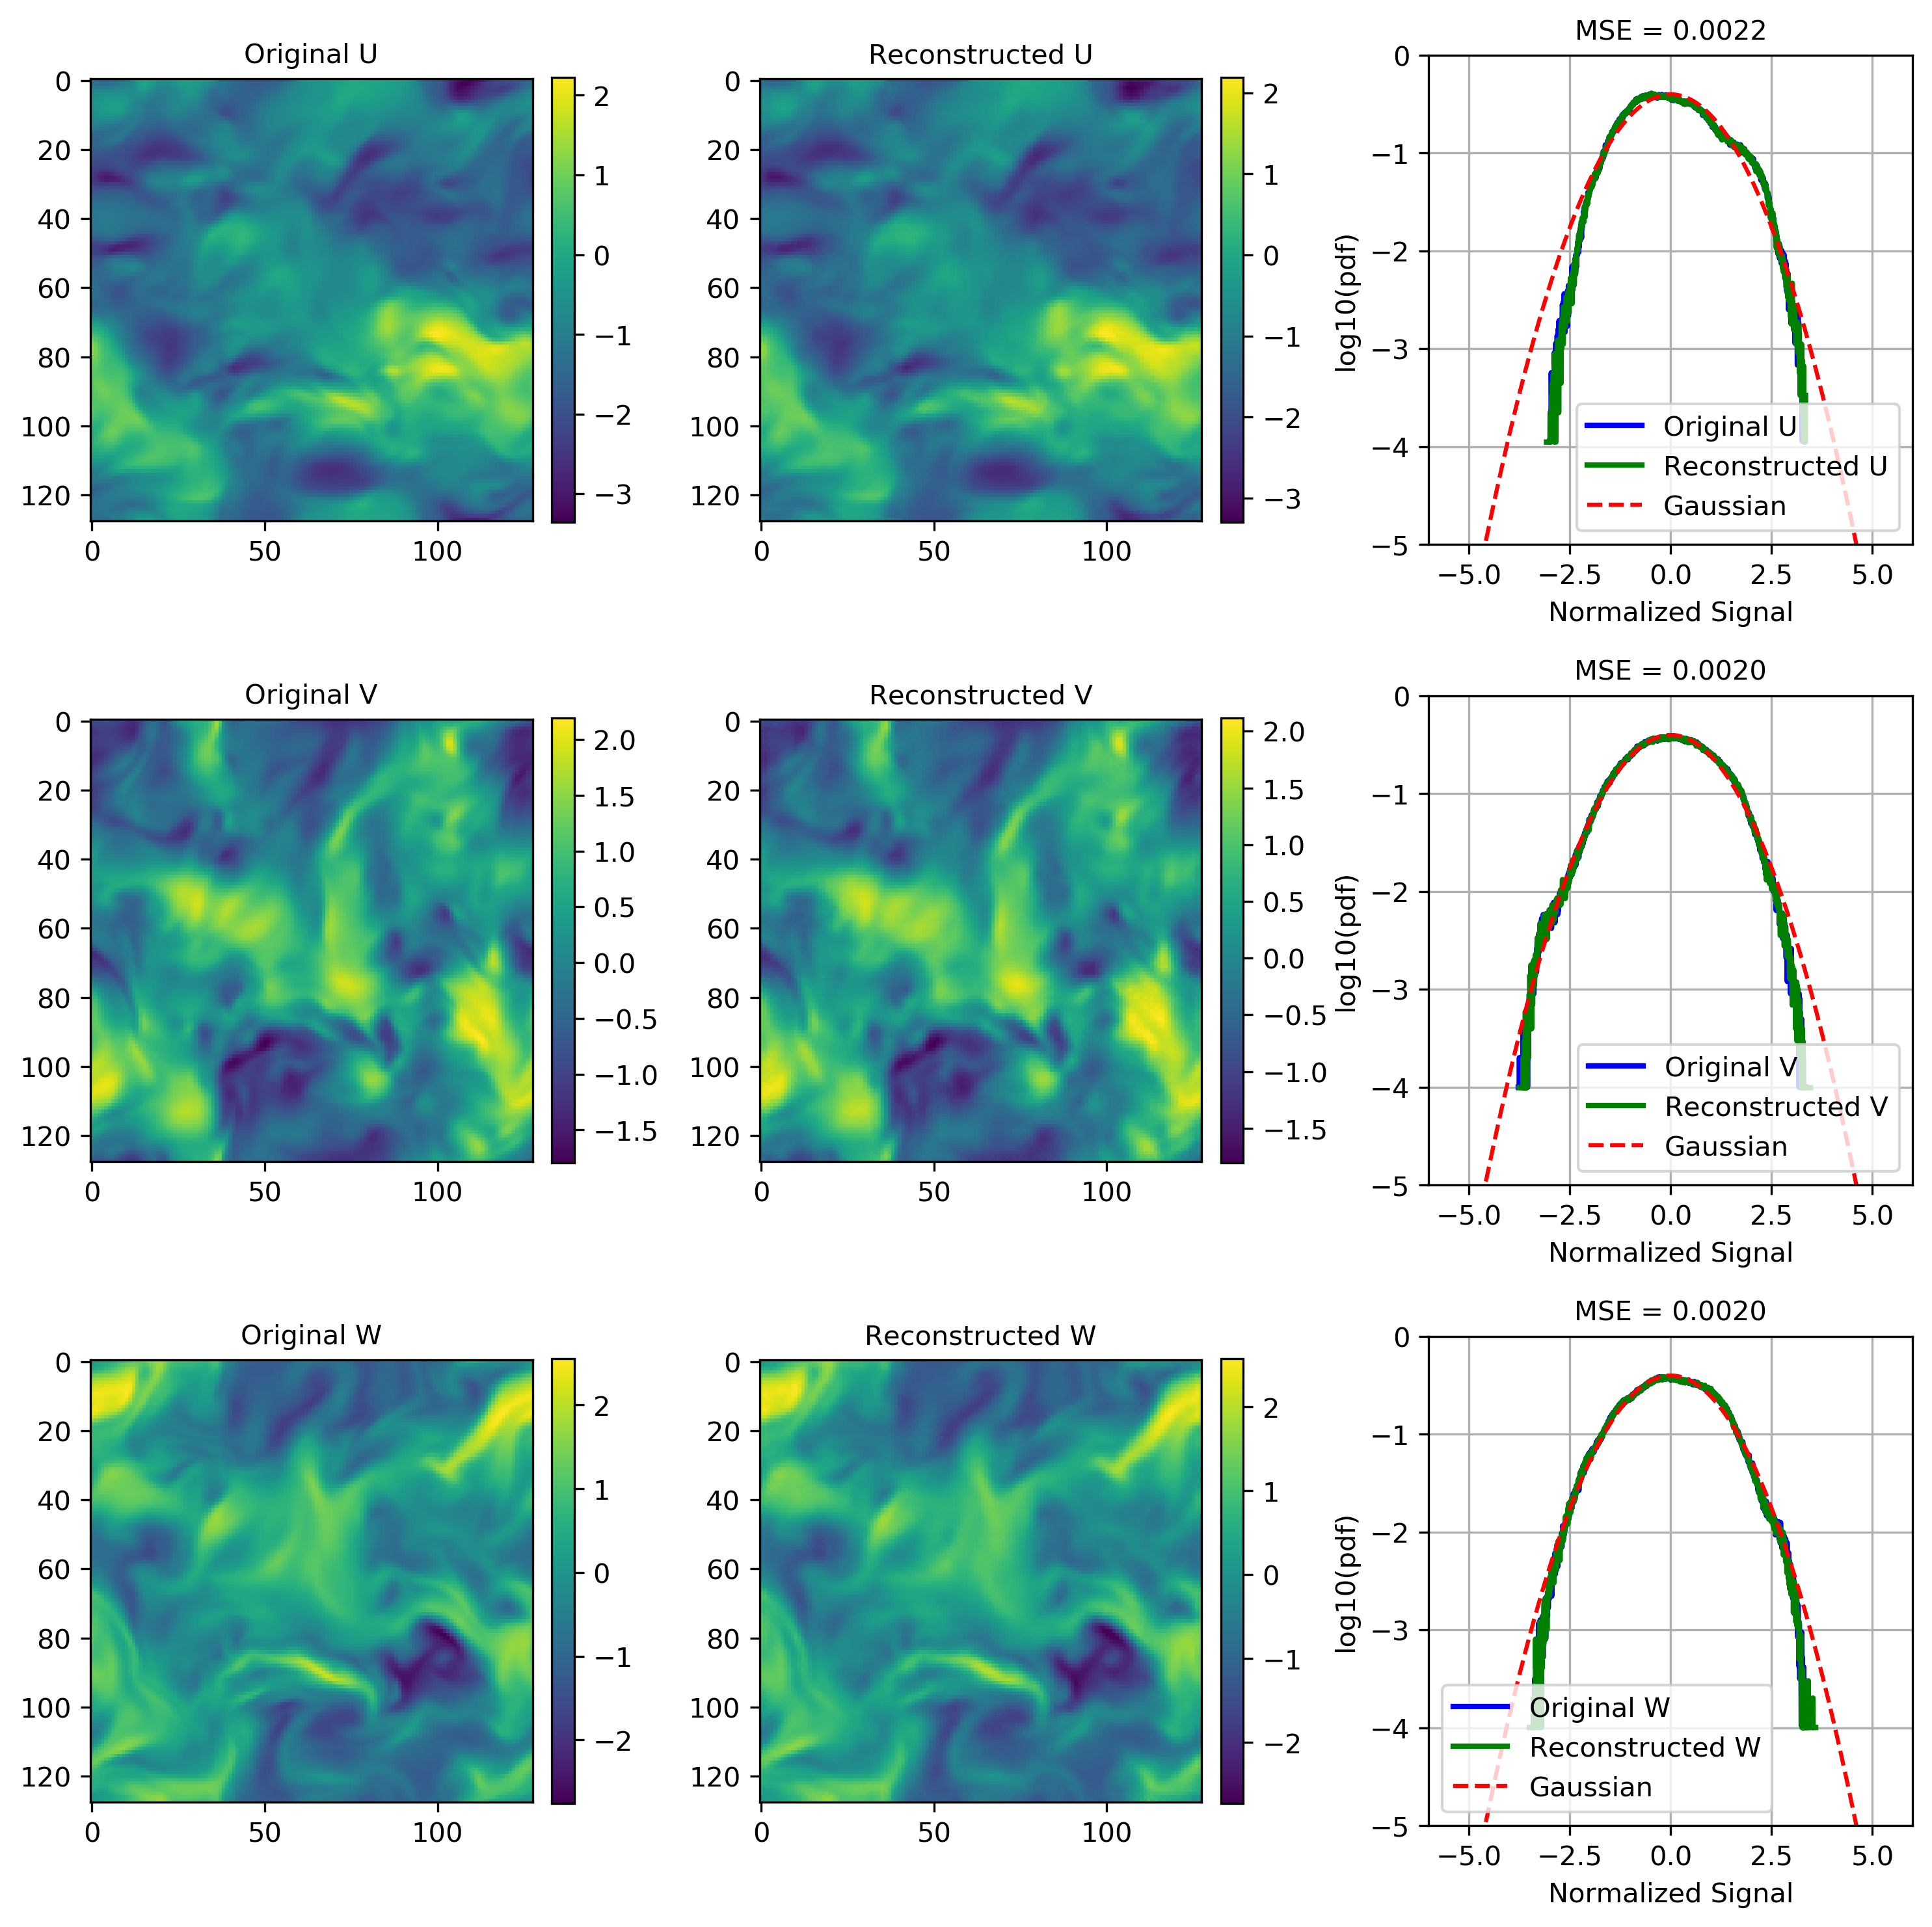
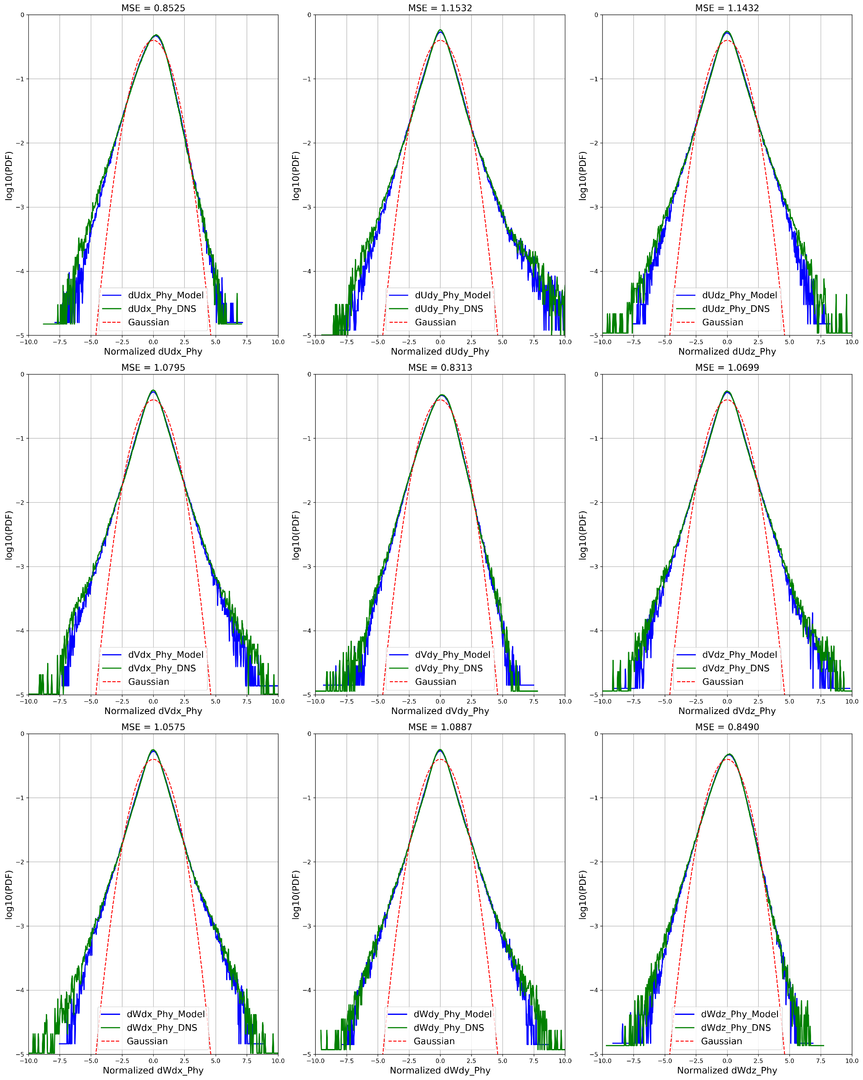
Smart Turbulence
Use VQ-VAE to first reduce 3D data (can be used in music and speech synthesis)
Add gradient constraint during training
Time series prediction on coded space using convolutional Transformer

Slide 6
Finite Neural Networks
Input, weights and output are all on finite field
I find formal derivatives can be defined for finite field with product rule of calculus
In mathematics, the formal derivative is an operation on elements of a polynomial ring or a ring of formal power series that mimics the form of the derivative from calculus.
https://en.wikipedia.org/wiki/Formal_derivative
For example d(X^5)/dx = 5X^4 which means summation of X^4 5 times. d(f(X)/5)/dx = 1/5 d(f(X))/dx in finite field means find a value that when add 5 times equal d(f(X))/dx.
I think it is feasible to implement Finite Neural Networks with these definition.

Slide 7
Subnetworks
Train the masking from controller
Compress a network with lottery ticket
Compress multiple subnetworks from one network conditional on some extra information
Consider a pretrained classifier or generator, we compress it to classify subclasses or to generate data class-conditionally

Slide 8
Others
Deep Channel Coding
Finished for ECE587, the result is promising
Frequency domain channel coding with Fourier operator
Defend adversarial attacks from intermediate layers
Hypothesis: Even though we only change very little to the input image and easily attack trained neural network. Intermediate layer features should have a very different distribution from the trained dataset. The change of result cannot happen within one layer. It is the deep nature makes classifier fragile
Design a simple Defensive BatchNorm to check statistics
Neural PDE sover
Fourier operator
SIREN network

Slide 9
Others
Neural Wavelet Transform
Train the kernel inside wavelet to replace convolution layer to reduce computation and kernel size
Possible extend to other integral transform
Model Recording without knowing training data
We may copy a model by training a generator to efficiently generate query and ask prediction from trained models
The generator is optimized from random noise and then exploit a data space that makes the recording of trained model faster than only using random noise
Predictive gradient descent, meta-learning
Forget about learning rate. Theoretically there always exists a best gradient step at each iteration. We use learning history as our training data and predict the best gradient step. Deep Learning for optimization.

Slide 10
Preliminary Exam
Requirements
1) a written dissertation research proposal
2) an oral presentation and defense of this proposal to an approved five-member faculty committee.
The written dissertation research proposal should consist of a 10-page (maximum) report plus appendices providing additional supporting information as well as an anticipated timeline for completion of all PhD degree requirements.
The oral presentation, approximately 45 minutes with extra time allotted for questions posed by the committee throughout and after the presentation, should reflect the contents of the report.

Slide 11
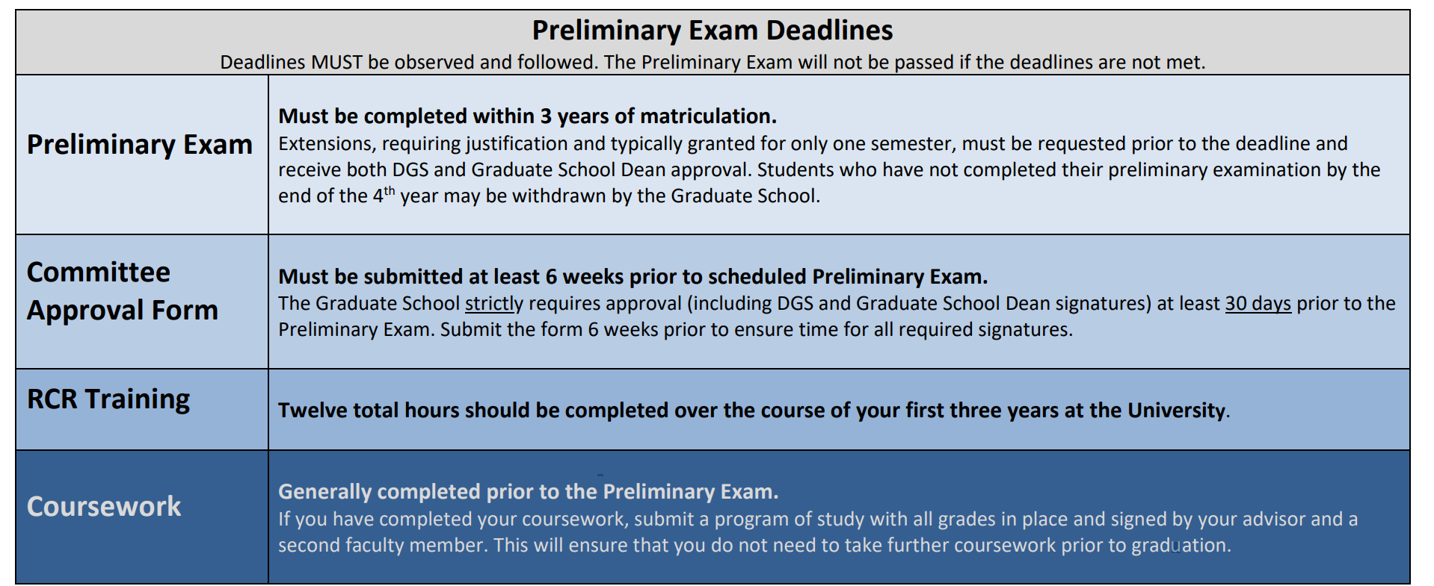
Preliminary Exam
Requirements

Slide 12
Preliminary Exam
Committee
The Graduate School strictly requires approval (including DGS and Graduate School Dean signatures) at least 30 days prior to the Preliminary Exam. Submit the form 6 weeks prior to ensure time for all required signatures.
Five members
Academic advisor
At least one committee member (the Minor Area Representative (MAR)) must be from a department or ECE field outside of the student’s major research area
Potential candidates:
Prof. Lawrence Carin
Prof. Guillermo Sapiro
Prof. Jeffrey Krolik
Prof. Robert Calderbank
Prof. Henry D. Pfister
Prof. Sina Farsiu
Prof. David Carlson
Prof. Yiran Chen
Prof. Helen Li

Slide 13
Preliminary Exam
Exam Details Form
Please enter your exam details at least three weeks prior to your exam here:
https://duke.qualtrics.com/jfe/form/SV_bygP2d2XkuLX1gp
I do not use Prelim Exam as MS Exam to earn MS degree
I have completed RCR training requirements
Which work I should present?
HeteroFL
Assisted Learning
Model Agnostic Decentralized Learning

Slide 14
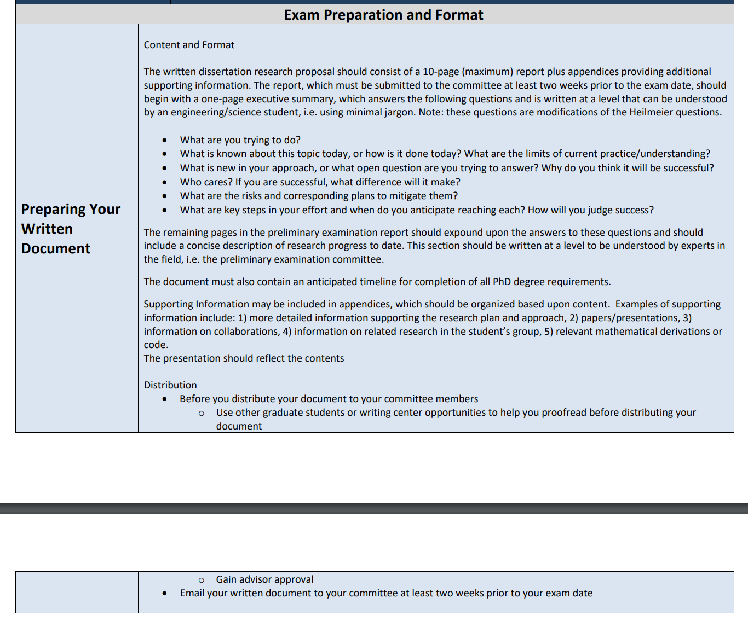
Preliminary Exam
Written Document

